Slide 1
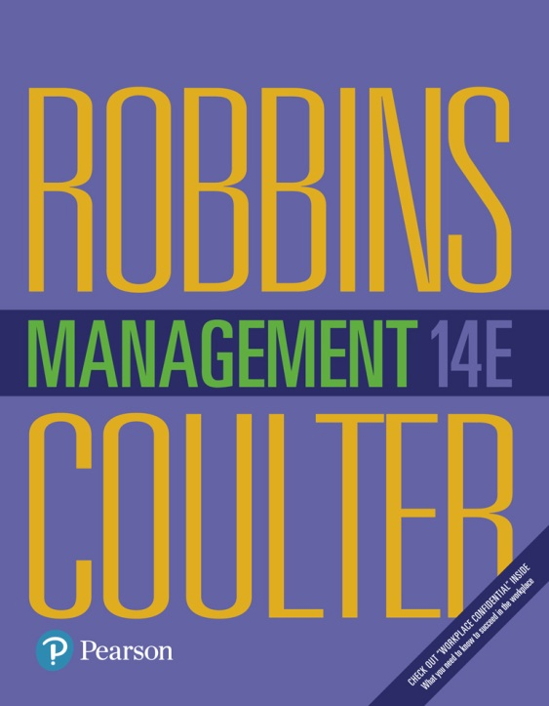
Management
Fourteenth Edition
Chapter 8
Planning Work Activities
Copyright © 2018, 2016, 2014 Pearson Education, Inc. All Rights Reserved

Slide 2
Learning Objectives
8.1 Define the nature and purposes of planning.
8.2 Classify the types of goals organizations might have and the plans they use.
8.3 Compare and contrast approaches to goal-setting and planning.
Know how to set goals personally and create a useful, functional to-do list
Develop your skill at helping your employees set goals
8.4 Discuss contemporary issues in planning.

Slide 3
What is Planning?
Planning: management function that involves setting goals, establishing strategies for achieving those goals, and developing plans to integrate and coordinate work activities
Formal planning
Specific, time-oriented goals
Goals written and shared
Notes:
Planning involves defining the organization’s goals, establishing strategies for achieving those goals, and developing plans to integrate and coordinate work activities. It’s concerned with both ends (what) and means (how).
When we use the term planning, we mean formal planning. In formal planning, specific goals covering a specific time period are defined. These goals are written and shared with organizational members to reduce ambiguity and create a common understanding about what needs to be done. Finally, specific plans exist for achieving these goals.

Slide 4
Why Do Managers Plan?
Provides direction
Reduces uncertainty
Minimizes waste and redundancy
Establishes the goals and standards for controlling
Notes:
So why should managers plan? We can give you at least four reasons.
First, planning provides direction to managers and nonmanagers alike. When employees know what their organization or work unit is trying to accomplish and what they must contribute to reach goals, they can coordinate their activities, cooperate with each other, and do what it takes to accomplish those goals.
Next, planning reduces uncertainty by forcing managers to look ahead, anticipate change, consider the impact of change, and develop appropriate responses. Although planning won’t eliminate uncertainty, managers plan so they can respond effectively.
In addition, planning minimizes waste and redundancy. When work activities are coordinated around plans, inefficiencies become obvious and can be corrected or eliminated.
Finally, planning establishes the goals or standards used in controlling. When managers plan, they develop goals and plans. When they control, they see whether the plans have been carried out and the goals met.

Slide 5
Planning and Performance
Formal planning is associated with positive financial results
Quality of planning/implementation more important than the extent of it
External factors can reduce the impact of planning on performance
Planning-performance relationship seems to be influenced by the planning time frame
Notes:
Numerous studies have shown generally positive relationships between planning and performance.
Formal planning is associated with positive financial results—higher profits, higher return on assets, and so forth.
Doing a good job of planning and implementing those plans plays a bigger part in high performance than how much planning is done.
In those studies where formal planning didn’t lead to higher performance, the external environment often was the culprit. When external forces—think governmental regulations or powerful labor unions—constrain managers’ options, it reduces the impact planning has on an organization’s performance.
Finally, the planning-performance relationship seems to be influenced by the planning time frame. It seems that at least four years of formal planning is required before it begins to affect performance.

Slide 6
Goals and Plans
Goals (objectives): desired outcomes or targets
Plans: documents that outline how goals are going to be met
Notes:
Goals (objectives) are desired outcomes or targets. They guide management decisions and form the criterion against which work results are measured. That’s why they’re often described as the essential elements of planning. You have to know the desired target or outcome before you can establish plans for reaching it.
Plans are documents that outline how goals are going to be met. They usually include resource allocations, schedules, and other necessary actions to accomplish the goals. As managers plan, they develop both goals and plans.

Slide 7
Types of Goals
Financial goals
Strategic goals
Stated goals: official statements of what an organization says, and what it wants its various stakeholders to believe, its goals are
Real goals: goals that an organization actually pursues, as defined by the actions of its members
Notes:
We can classify most company’s goals as either strategic or financial. Financial goals are related to the financial performance of the organization, while strategic goals are related to all other areas of an organization’s performance. For instance, discount retailer Dollar General announced its plan to demonstrate sales growth of 7–10 percent in 2016, with earnings per share (profit divided by the total number of company stock shares) to increase by 10–15 percent.6 And here’s an example of a strategic goal from the United Nations World Food Programs: to ensure that no child goes to bed hungry.
Stated goals are official statements of what an organization says, and what it wants its stakeholders to believe, its goals are. However, stated goals—which can be found in an organization’s charter, annual report, public relations announcements, or in public statements made by managers—are often conflicting and influenced by what various stakeholders think organizations should do.
If you want to know an organization’s real goals—those goals an organization actually pursues—observe what organizational members are doing. Actions define priorities.

Slide 8
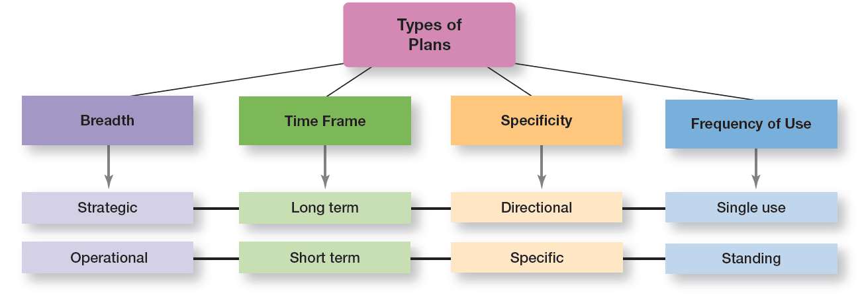
Exhibit 8-1 Types of Plans
Exhibit 8-1 shows the most popular ways to describe organizational plans.
Notes:
As Exhibit 8-1 shows, these types of plans aren’t independent. That is, strategic plans are usually long-term, directional, and single use, whereas operational plans are usually short-term, specific, and standing.

Slide 9
Strategic and Operational Plans
Strategic plans: plans that apply to the entire organization and establish the organization’s overall goals
Operational plans: plans that encompass a particular operational area of the organization
Notes:
The most popular ways to describe organizational plans are breadth (strategic versus operational), time frame (short-term versus long-term), specificity (directional versus specific), and frequency of use (single use versus standing).
Strategic plans are plans that apply to the entire organization and establish the organization’s overall goals. Plans that encompass a particular operational area of the organization are called operational plans. These two types of plans differ because strategic plans are broad while operational plans are narrow.

Slide 10
Long-term and Short-term Plans
Long-term plans: plans with a time frame beyond three years
Short-term plans: plans covering one year or less
Notes:
Any time period in between would be an intermediate plan. Although these time classifications are fairly common, an organization can use any planning time frame it wants.

Slide 11
Specific and Directional Plans
Specific plans: plans that are clearly defined and leave no room for interpretation
Directional plans: plans that are flexible and set out general guidelines
Notes:
Specific plans are clearly defined and leave no room for interpretation. A specific plan states its objectives in a way that eliminates ambiguity and problems with misunderstanding.
Directional plans are flexible plans that set out general guidelines. They provide focus but don’t lock managers into specific goals or courses of action.

Slide 12
Single-use and Standing Plans
Specific plans: a one-time plan specifically designed to meet the needs of a unique situation
Directional plans: ongoing plans that provide guidance for activities performed repeatedly
Notes:
Some plans that managers develop are ongoing while others are used only once. A single-use plan is a one-time plan specifically designed to meet the needs of a unique situation.
In contrast, standing plans are ongoing plans that provide guidance for activities performed repeatedly. Standing plans include policies, rules, and procedures.

Slide 13
Approaches to Setting Goals
Traditional goal-setting: an approach to setting goals in which top managers set goals that then flow down through the organization and become subgoals for each organizational area
Notes:
Turning broad strategic goals into departmental, team, and individual goals can be a di cult and frustrating process.
Another problem with traditional goal-setting is that when top managers define the organization’s goals in broad terms—such as achieving “sufficient” profits or increasing “market leadership”—these ambiguous goals have to be made more specific as they ow down through the organization. Managers at each level define the goals and apply their own interpretations and biases as they make them more specific. However, what often happens is that clarity is lost as the goals make their way down from the top of the organization to lower levels.

Slide 14
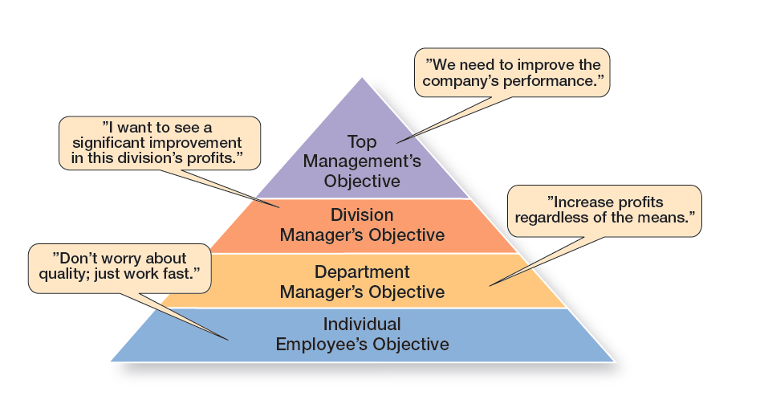
Exhibit 8-2 The Downside of Traditional Goal-Setting
Exhibit 8-2 illustrates what can happen as the goals make their way down from the top of the organization to lower levels.
Notes:
What often happens is that clarity is lost as the goals make their way down from the top of the organization to lower levels. Exhibit 8-2 illustrates what can happen.

Slide 15
Means-Ends Chain and MBO
Means-ends chain: an integrated network of goals in which the accomplishment of goals at one level serves as the means for achieving the goals, or ends, at the next level
Management by objectives (MBO): a process of setting mutually agreed upon goals and using those goals to evaluate employee performance
Notes:
Higher-level goals (or ends) are linked to lower-level goals, which serve as the means for their accomplishment.
MBO programs have four elements: goal specificity, participative decision making, an explicit time period, and performance feedback. Instead of using goals to make sure employees are doing what they’re supposed to be doing, MBO uses goals to motivate them as well. The appeal is that it focuses on employees working to accomplish goals they’ve had a hand in setting.

Slide 16
Exhibit 8-3 Steps in MBO
Step
Step 1: The organization’s overall objectives and strategies are formulated.
Step 2: Major objectives are allocated among divisional and departmental units.
Step 3: Unit managers collaboratively set specific objectives for their units with their managers.
Step 4: Specific objectives are collaboratively set with all department members.
Step 5: Action plans, defining how objectives are to be achieved, are specified and agreed upon by managers and employees.
Step 6: The action plans are implemented.
Step 7: Progress toward objectives is periodically reviewed, and feedback is provided.
Step 8: Successful achievement of objectives is reinforced by performance-based rewards.
Notes:
Exhibit 8-3 lists the steps in a typical MBO program.

Slide 17
Exhibit 8-4 Well-Written Goals
Characteristics
Written in terms of outcomes rather than actions
Measurable and quantifiable
Clear as to a time frame
Challenging yet attainable
Written down
Communicated to all necessary organizational members
Notes:
Goals aren’t all written the same way. Some are better than others at making the desired outcomes clear.
Managers should be able to write well-written work goals. What makes a “well-written” work goal? Exhibit 8-4 lists the characteristics.

Slide 18
Steps in Goal-Setting
1. Review the organization’s mission, or purpose.
2. Evaluate available resources.
3. Determine the goals individually or with input from others.
4. Write down the goals and communicate them to all who need to know.
5. Review results and whether goals are being met.
Notes:
Managers should follow five steps when setting goals.
Review the organization’s mission, or purpose. A mission is a broad statement of an organization’s purpose that provides an overall guide to what organizational members think is important. Managers should review the mission before writing goals because goals should reflect that mission.
Evaluate available resources. You don’t want to set goals that are impossible to achieve given your available resources. Even though goals should be challenging, they should be realistic. After all, if the resources you have to work with won’t allow you to achieve a goal no matter how hard you try or how much effort is exerted, you shouldn’t set that goal.
Determine the goals individually or with input from others. The goals reflect desired outcomes and should be congruent with the organizational mission and goals in other organizational areas. These goals should be measurable, specific, and include a time frame for accomplishment.
Write down the goals and communicate them to all who need to know. Writing down and communicating goals forces people to think them through. The written goals also become visible evidence of the importance of working toward something.
Review results and whether goals are being met. If goals aren’t being met, change them as needed. Once the goals have been established, written down, and communicated, a manager is ready to develop plans for pursuing the goals.

Slide 19
Developing Plans
Contingency factors in planning:
Organizational level
Degree of environmental uncertainty
Length of future commitments
Notes:
Higher-level goals (or ends) are linked to lower-level goals, which serve as the means for their accomplishment.
MBO programs have four elements: goal specificity, participative decision making, an explicit time period, and performance feedback. Instead of using goals to make sure employees are doing what they’re supposed to be doing, MBO uses goals to motivate them as well. The appeal is that it focuses on employees working to accomplish goals they’ve had a hand in setting.

Slide 20
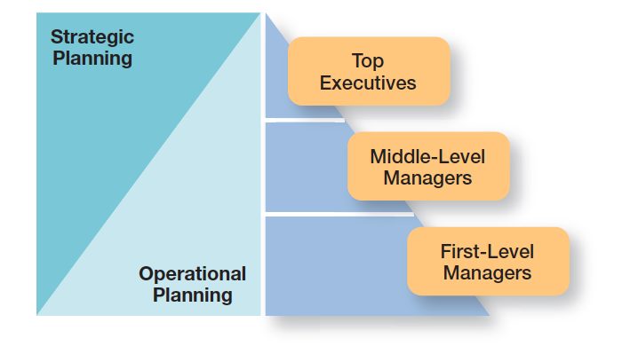
Exhibit 8-5 Planning and Organizational Level
Exhibit 8-5 shows the relationship between a manager’s level in the organization and the type of planning done.
Notes:
Exhibit 8-5 shows the relationship between a manager’s level in the organization and the type of planning done. For the most part, lower-level managers do operational planning while upper-level managers do strategic planning.

Slide 21
Environmental Uncertainty
When uncertainty is high, plans should be specific, but flexible.
Notes:
Managers must be prepared to change or amend plans as they’re implemented. At times, they may even have to abandon the plans.

Slide 22
Length of Future Commitments
Commitment concept: plans should extend far enough to meet those commitments made when the plans were developed
Notes:
Higher-level goals (or ends) are linked to lower-level goals, which serve as the means for their accomplishment.
MBO programs have four elements: goal specificity, participative decision making, an explicit time period, and performance feedback. Instead of using goals to make sure employees are doing what they’re supposed to be doing, MBO uses goals to motivate them as well. The appeal is that it focuses on employees working to accomplish goals they’ve had a hand in setting.

Slide 23
Approaches to Planning
Formal planning department: a group of planning specialists whose sole responsibility is helping to write organizational plans
Notes:
In the traditional approach, planning is done entirely by top-level managers who are often assisted by a formal planning department, a group of planning specialists whose sole responsibility is to help write the various organizational plans. Under this approach, plans developed by top-level managers flow down through other organizational levels, much like the traditional approach to goal-setting. As they flow down through the organization, the plans are tailored to the particular needs of each level.
Although this approach makes managerial planning thorough, systematic, and coordinated, all too often the focus is on developing “the plan”—a thick binder (or binders) full of meaningless information that’s stuck on a shelf and never used by anyone for guiding or coordinating work efforts

Slide 24
How Can Managers Plan Effectively in Dynamic Environments?
Develop plans that are specific but flexible
Keep planning even when the environment is uncertain
Allow lower organizational levels to set goals and develop plans
Notes:
In an uncertain environment, managers should develop plans that are specific, but flexible. Although this may seem contradictory, it’s not. To be useful, plans need some specificity, but the plans should not be set in stone. Managers need to recognize that planning is an ongoing process. The plans serve as a road map, although the destination may change due to dynamic market conditions.
Keep in mind, also, that even when the environment is highly uncertain, it’s important to continue formal planning in order to see any effect on organizational performance. It’s the persistence in planning that contributes to significant performance improvement. Why? It seems that, as with most activities, managers “learn to plan,” and the quality of their planning improves when they continue to do it.
Finally, make the organizational hierarchy flatter to effectively plan in dynamic environments. This means allowing lower organizational levels to set goals and develop plans because there’s little time for goals and plans to ow down from the top. Managers should teach their employees how to set goals and to plan and then trust them to do it.

Slide 25
How Can Managers Use Environmental Scanning?
Environmental scanning: screening information to detect emerging trends
Competitor intelligence: gathering information about competitors that allows managers to anticipate competitors’ actions rather than merely react to them
Notes:
A manager’s analysis of the external environment may be improved by environmental scanning, which involves screening information to detect emerging trends. One of the fastest-growing forms of environmental scanning is competitor intelligence, gathering information about competitors that allows managers to anticipate competitors’ actions rather than merely react to them.
In a changing global business environment, environmental scanning and obtaining competitive intelligence can be quite complex, especially since information must be gathered from around the world. However, one thing managers could do is subscribe to news services that review newspapers and magazines from around the globe and provide summaries to client companies.
Managers do need to be careful about the way information, especially competitive intelligence, is gathered to prevent any concerns about whether it’s legal or ethical.

Slide 26
Digital Tools
Business intelligence: data that managers can use to make more effective strategic decisions
Digital tools: technology, systems, or software that allow the user to collect, visualize, understand, or analyze data
Notes:
Increasingly, we’re finding that companies are making strategic changes based on data, as distinct from day-to-day decisions. These leaders understand the importance of business intelligence in their planning process. Sources of business intelligence are company records, industry trends, and competitors’ financial (for example, profits) or market (for example, market penetration) data.
How do managers make sense of vast amounts of data? Managers can use digital tools to make sense of business intelligence data. Digital tools refer to technology, systems, or software that allow the user to collect, visualize, understand, or analyze data. Specific examples of digital tools include software such as Microsoft Excel, online services such as Google Analytics, or networks that connect computers and people, such as social media.

Slide 27
Three Prevalent Digital Tools
Data visualization tools
Cloud computing: refers to storing and accessing data on the Internet rather than on a computer’s hard drive or a company’s network
Internet of things (IoT): allows everyday “things” to generate and store and share data across the Internet
Notes:
Tableau is an example of a company that provides software tools and interactive dashboards that allow users to generate useful business insights through the analysis and visualization of data.
The cloud is just a metaphor for the Internet.
In the Future Vision feature in Chapter 7, we described the Internet of Things (IoT), which allows everyday “things” to generate and store data about their own performance and share that information across the Internet.

Slide 28
Review Learning Objective 8.1
Define the nature and purposes of planning.
Planning involves defining the organization’s goals, establishing an overall strategy for achieving those goals, and developing plans for organizational work activities.
The four purposes of planning include providing direction, reducing uncertainty, minimizing waste and redundancy, and establishing the goals or standards used in controlling.
Notes:
Planning involves defining the organization’s goals, establishing an overall strategy for achieving those goals, and developing plans for organizational work activities. The four purposes of planning include providing direction, reducing uncertainty, minimizing waste and redundancy, and establishing the goals or standards used in controlling. Studies of the planning-performance relationship have concluded that formal planning is associated with positive financial performance, for the most part; it’s more important to do a good job of planning and implementing the plans than doing more extensive planning; the external environment is usually the reason why companies that plan don’t achieve high levels of performance; and the planning–performance relationship seems to be influenced by the planning time frame.

Slide 29
Review Learning Objective 8.2
Classify the types of goals organizations might have and the plans they use.
Goals are desired outcomes. Plans are documents that outline how goals will be met.
Strategic/financial
Stated/real
Long-term/short-term
Specific/directional
Single-use/standing
Notes:
Goals might be strategic or financial, and they might be stated or real. Strategic plans apply to the entire organization, while operational plans encompass a particular functional area. Long-term plans are those with a time frame beyond three years. Short-term plans cover one year or less. Specific plans are clearly defined and leave no room for interpretation. Directional plans are flexible and set out general guidelines. A single-use plan is a one-time plan designed to meet the needs of a unique situation. Standing plans are ongoing plans that provide guidance for activities performed repeatedly.

Slide 30
Review Learning Objective 8.3
Compare and contrast approaches to goal-setting and planning.
Traditional goal-setting and MBO
Six characteristics of well-written goals
Five steps of goal-setting
Contingency factors
Notes:
In traditional goal-setting, goals are set at the top of the organization and then become subgoals for each organizational area. MBO (management by objectives) is a process of setting mutually agreed-upon goals and using those goals to evaluate employee performance. Well-written goals have six characteristics: They are (1) written in terms of outcomes, (2) measurable and quantifiable, (3) clear as to time frame, (4) challenging but attainable, (5) written down, and (6) communicated to all organizational members who need to know them.
Goal-setting involves these steps: review the organization’s mission; evaluate available resources; determine the goals individually or with input from others; write down the goals and communicate them to all who need to know them; and review results and change goals as needed.
The contingency factors that affect planning include the manager’s level in the organization, the degree of environmental uncertainty, and the length of future commitments. The two main approaches to planning include the traditional approach, which has plans developed by top managers that ow down through other organizational levels and which may use a formal planning department. The other approach is to involve more organizational members in the planning process.

Slide 31
Review Learning Objective 8.4
Discuss contemporary issues in planning.
Planning in dynamic environments
Environmental scanning
Competitive intelligence
Digital tools
Notes:
One contemporary planning issue is planning in dynamic environments, which usually means developing plans that are specific but flexible. Also, it’s important to continue planning, even when the environment is highly uncertain. Finally, because there’s little time in a dynamic environment for goals and plans to ow down from the top, lower organizational levels should be allowed to set goals and develop plans. Another contemporary planning issue involves using environmental scanning to help do a better analysis of the external environment. One form of environmental scanning, competitive intelligence, can be especially helpful in finding out what competitors are doing. Organizations can gather business intelligence using a variety of digital tools to collect and analyze quantitative and qualitative data to support decision-making.

Slide 32
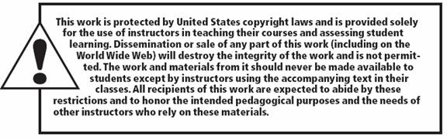
Copyright

